Slide 1
Hello World!

Slide 2
Azure for Trainers
Donnertag, 1. Januar 2021
News
TTT 22
Zusammenarbeit auf GitHub
Blog
Repo

Slide 3
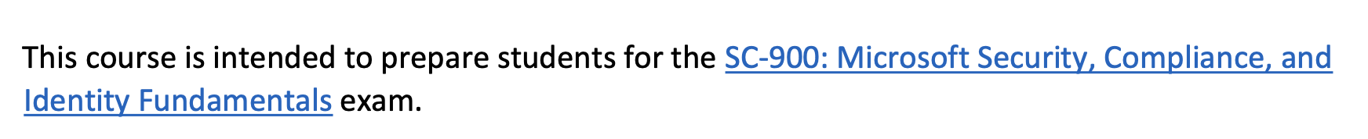
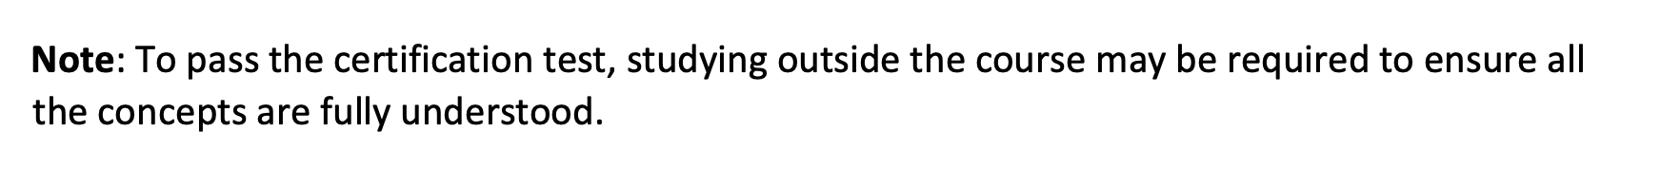
SC-900

Slide 4
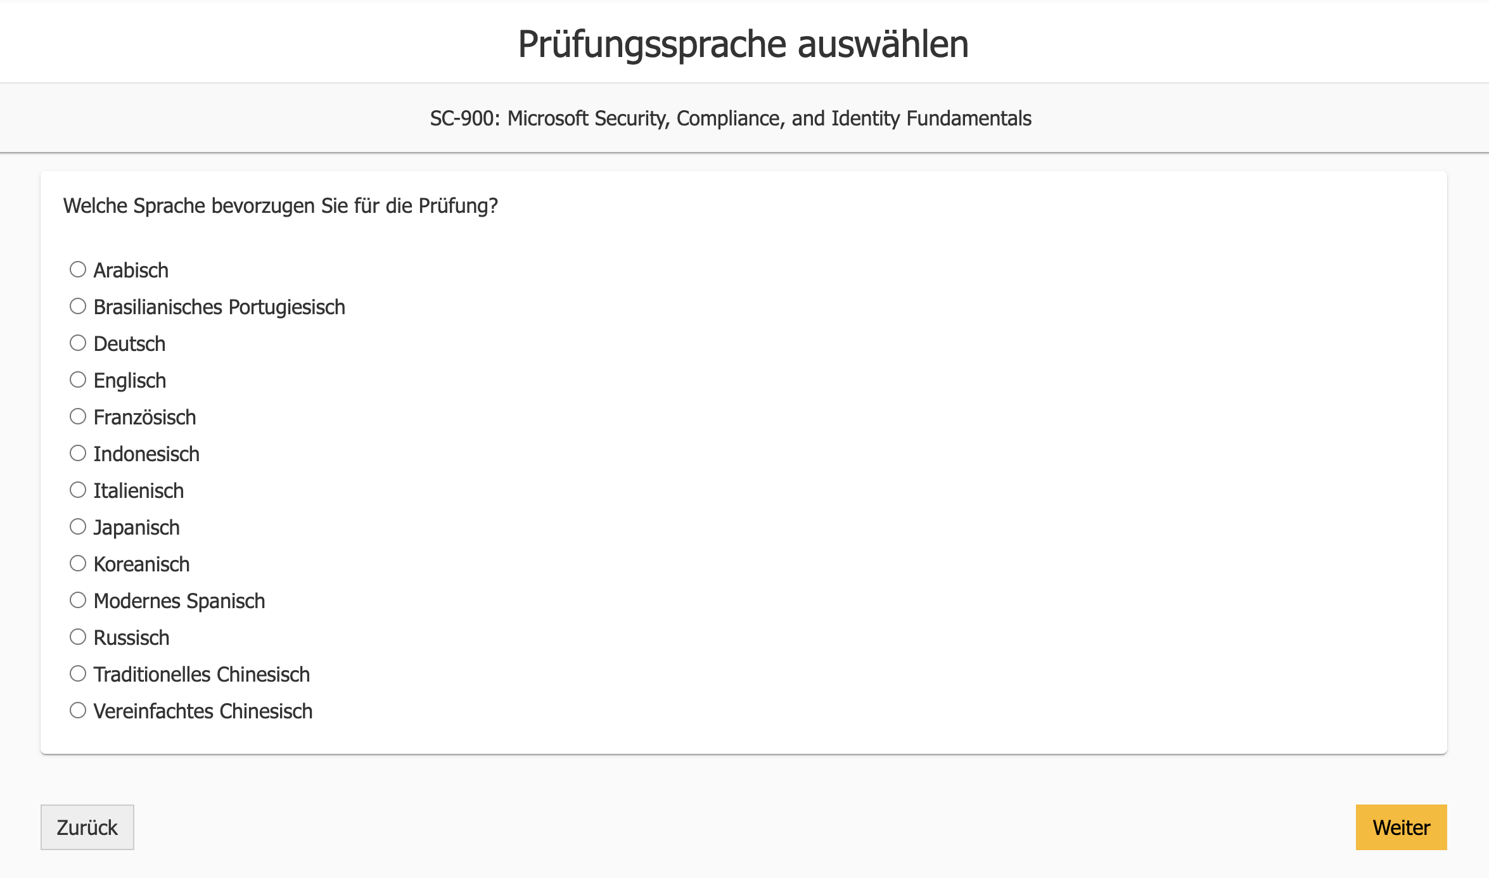
SC-900

Slide 5
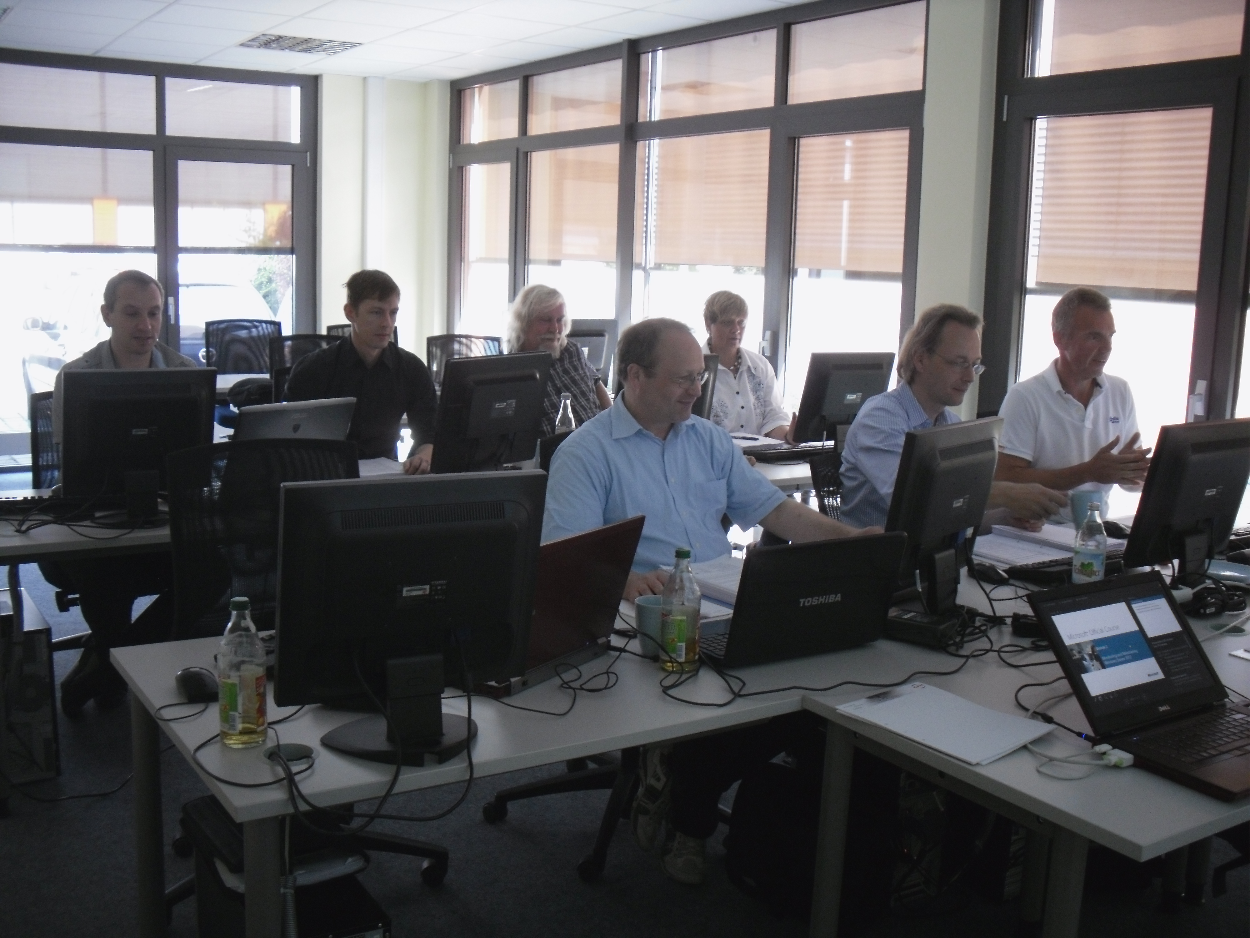
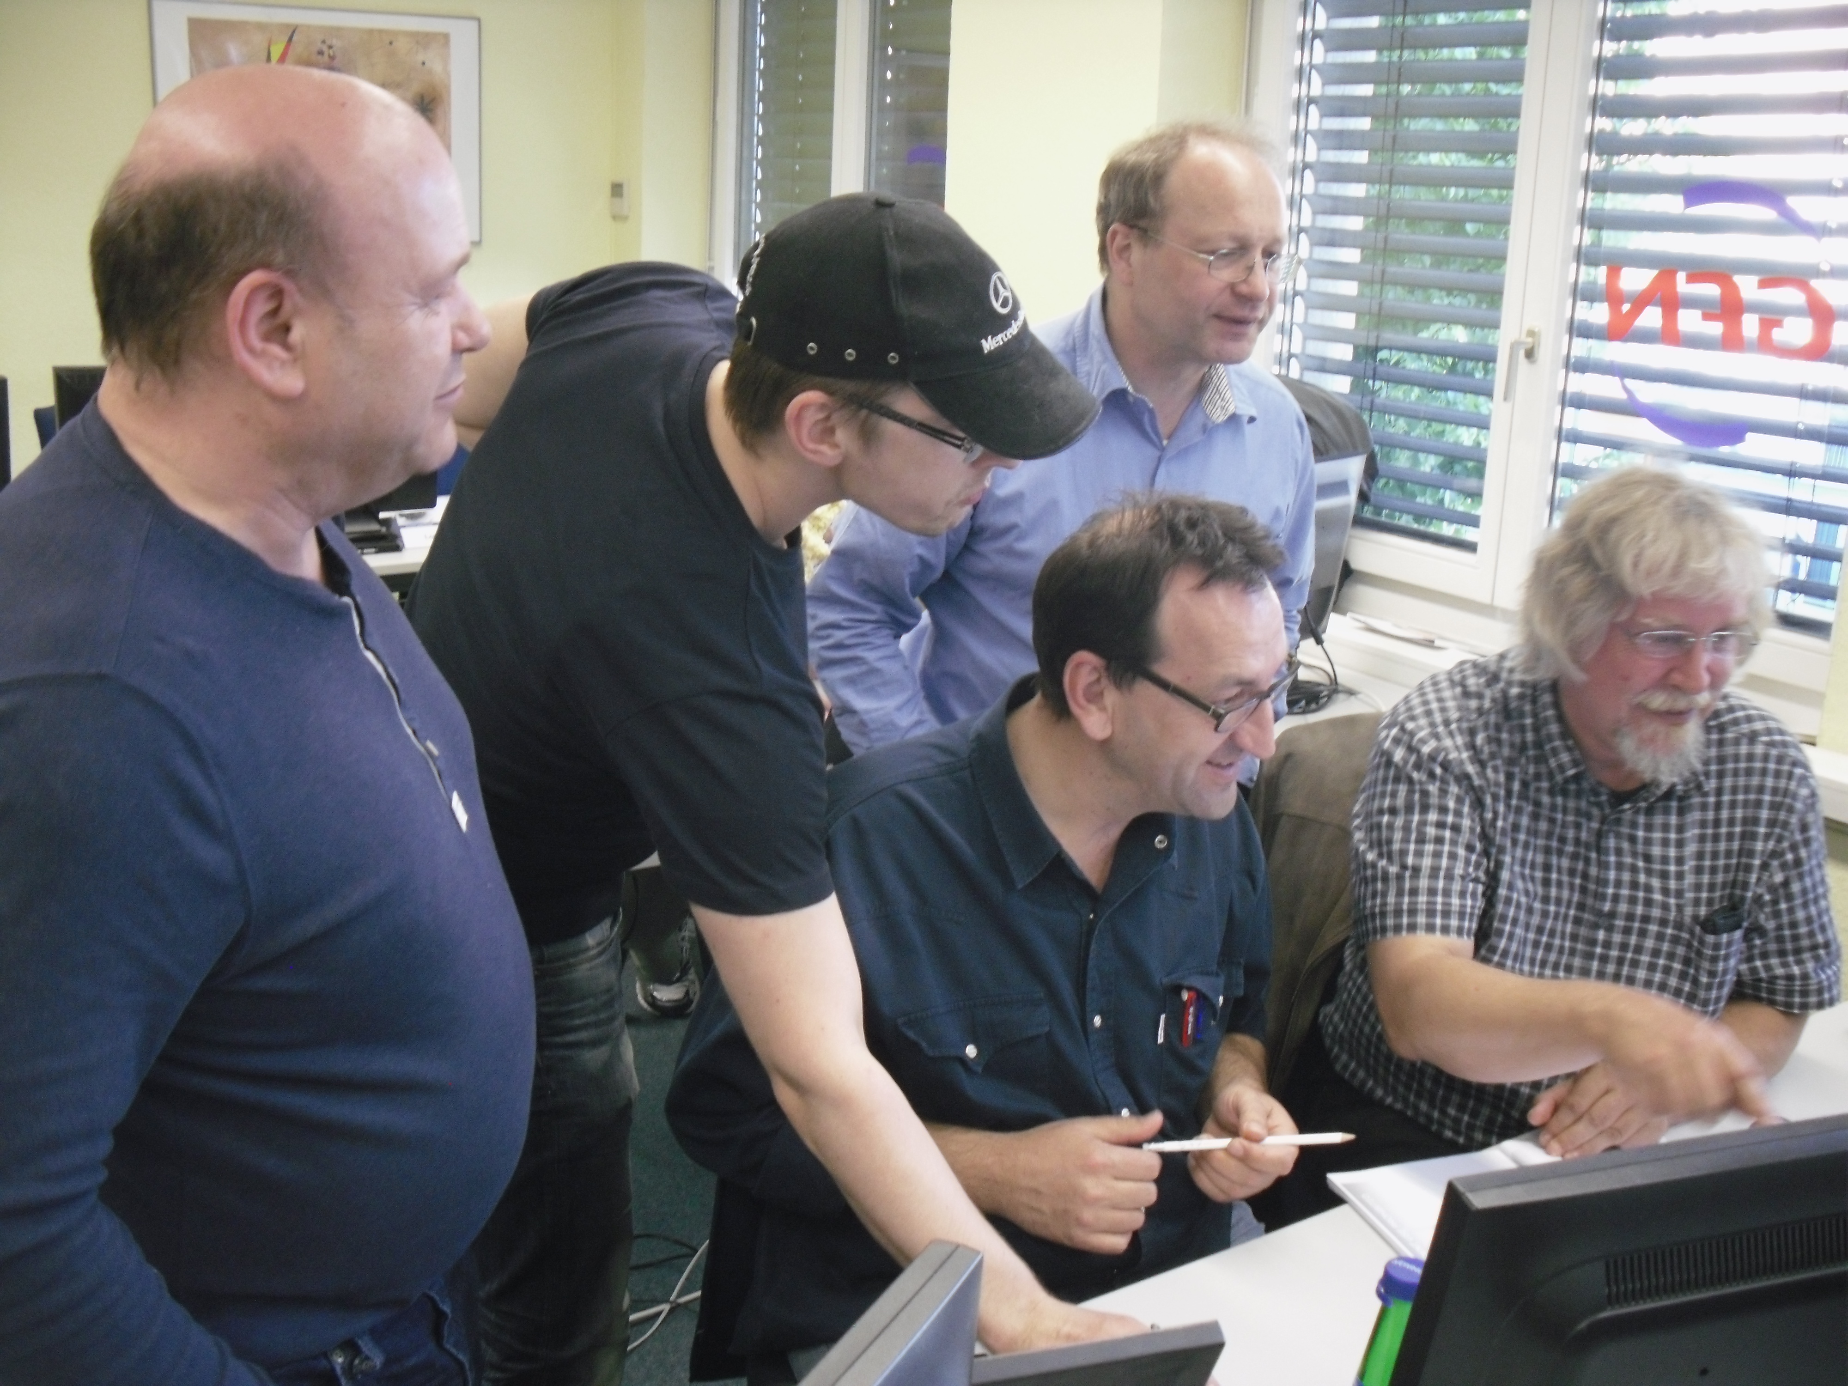
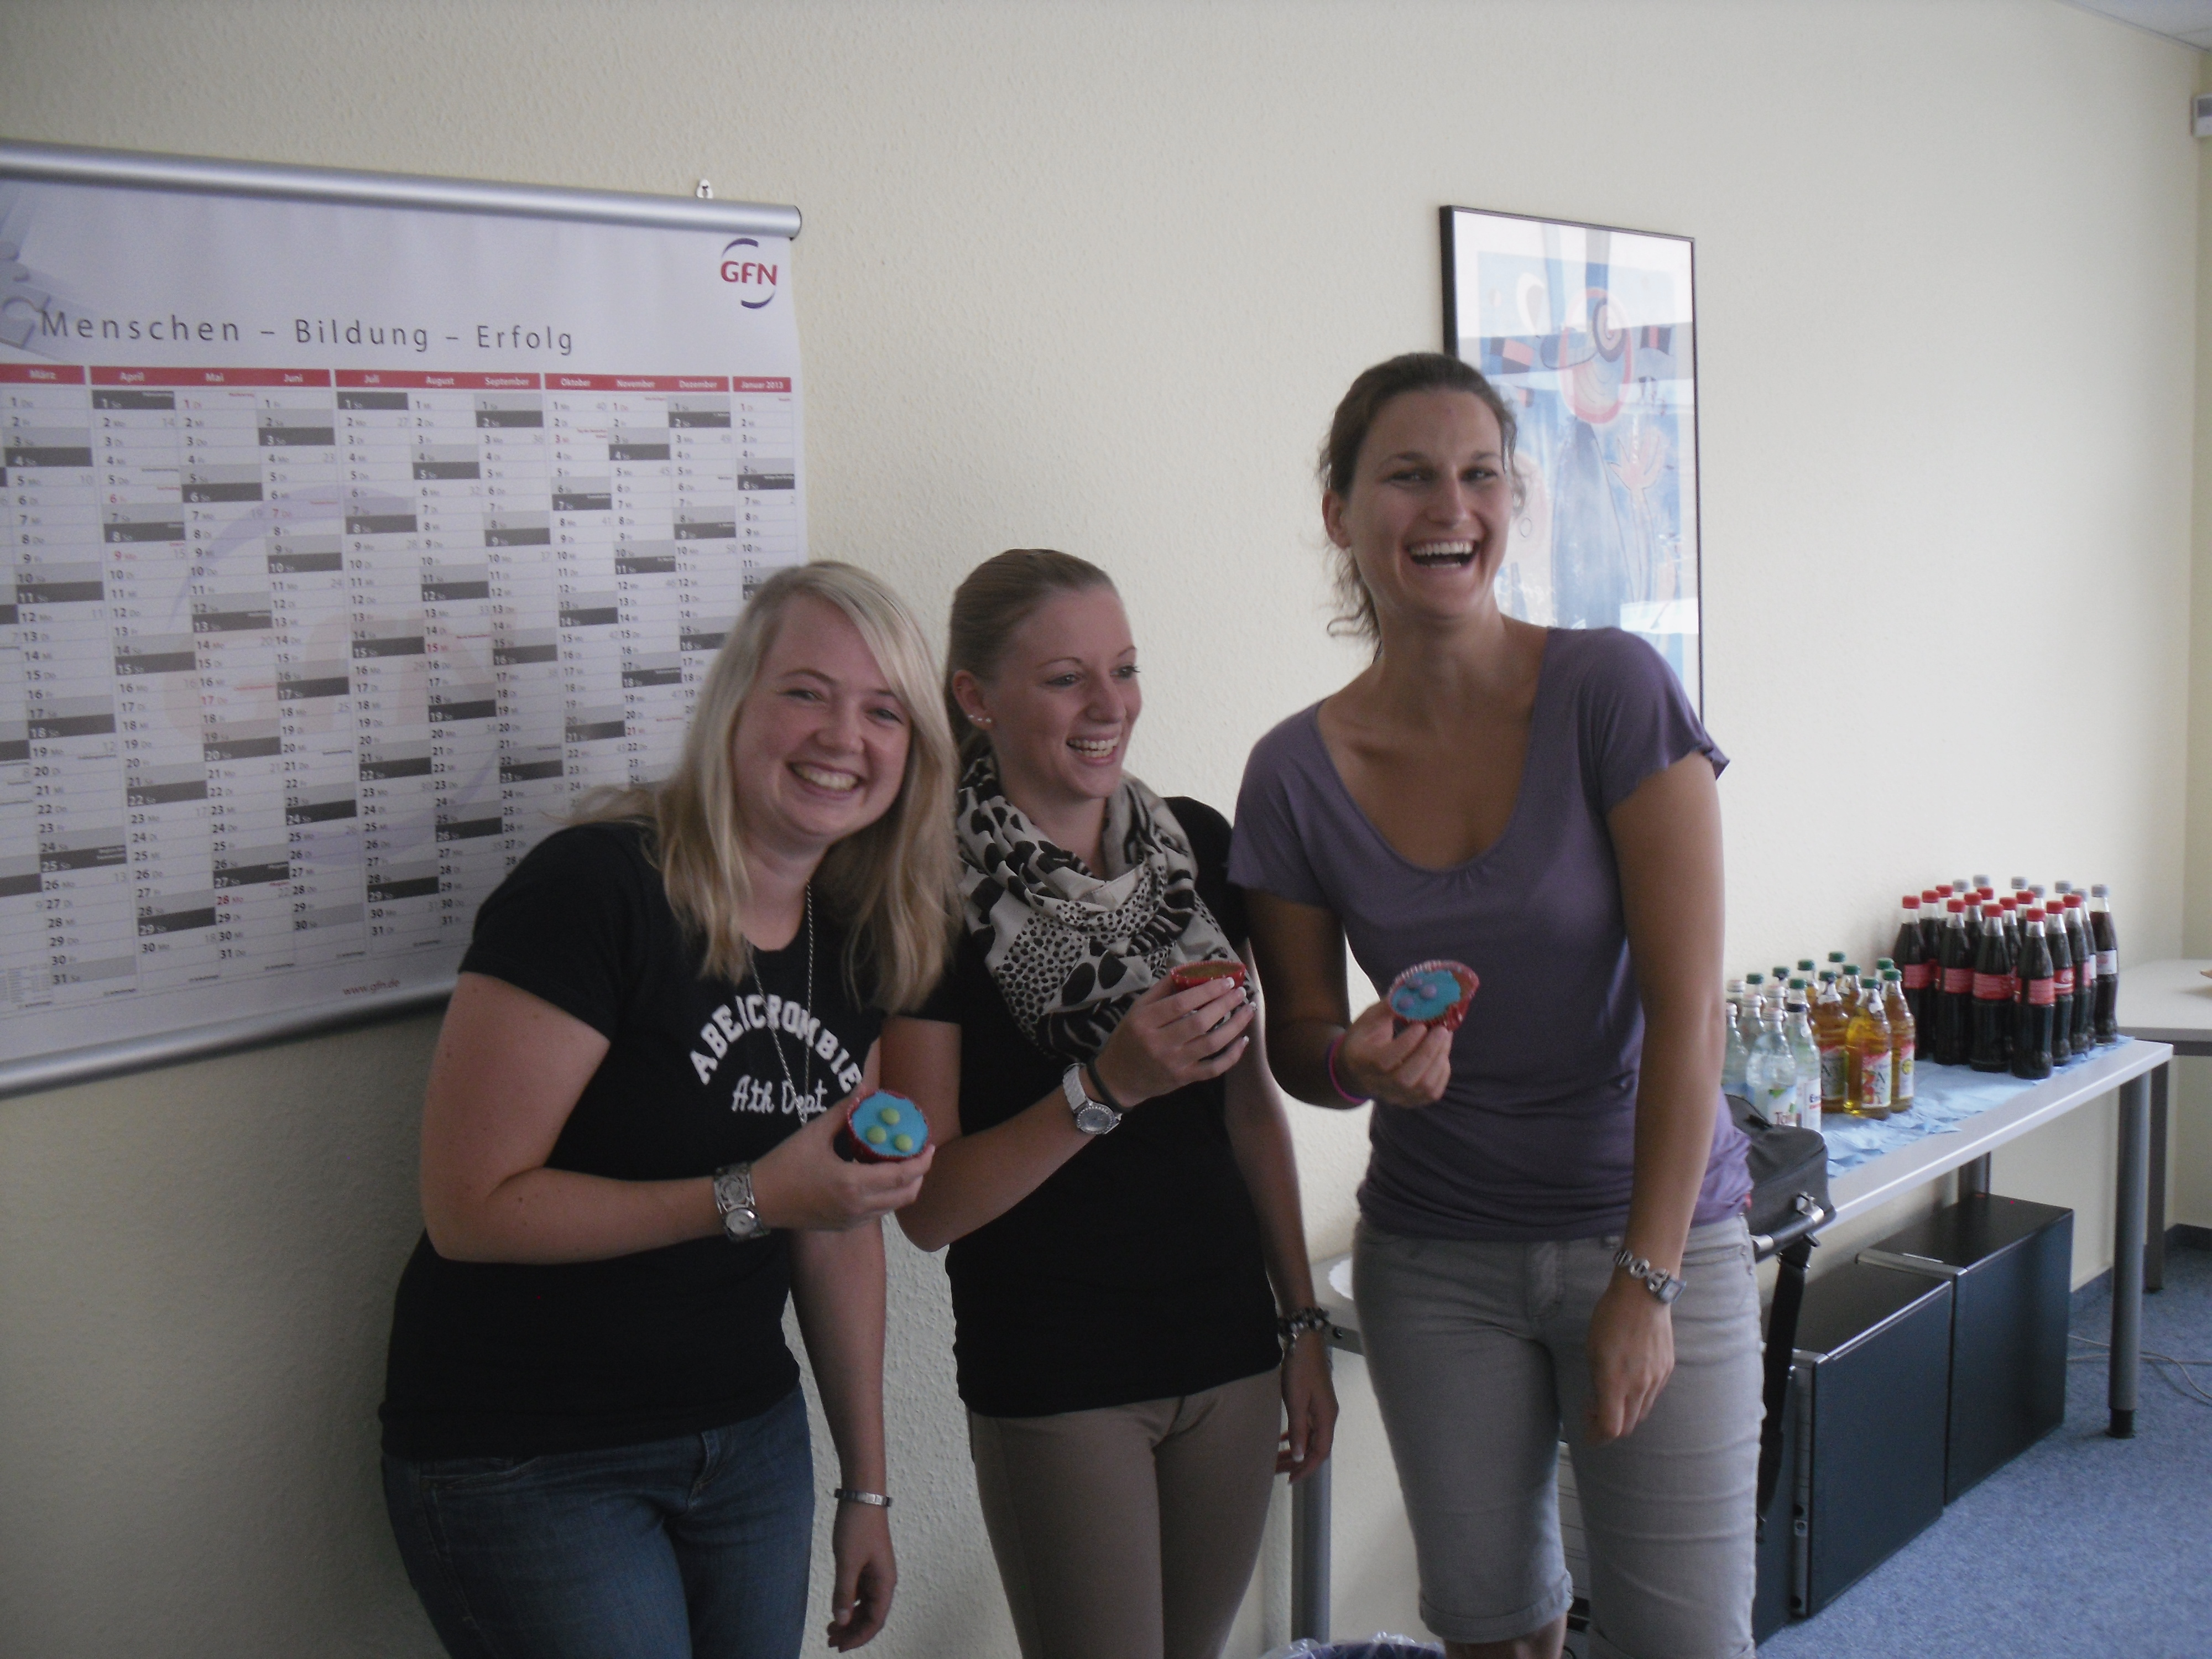
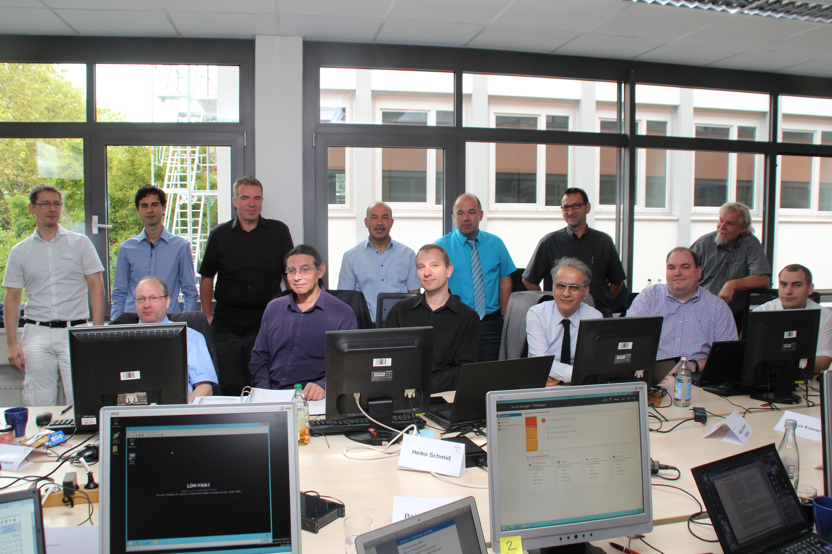
Train The Trainer
3. – 7. Januar 2022
Azure – Authentication – Authorization – Apps
SC-900

Slide 6
Zusammenarbeit auf GitHub (GH)
GH Repos
GH Web Editor
GH Pages
GH Actions
GH Pull Requests

Slide 7
GitHub Pull Requests
Fork Repo
Create new branch
Add changes
Do pull request

Slide 8
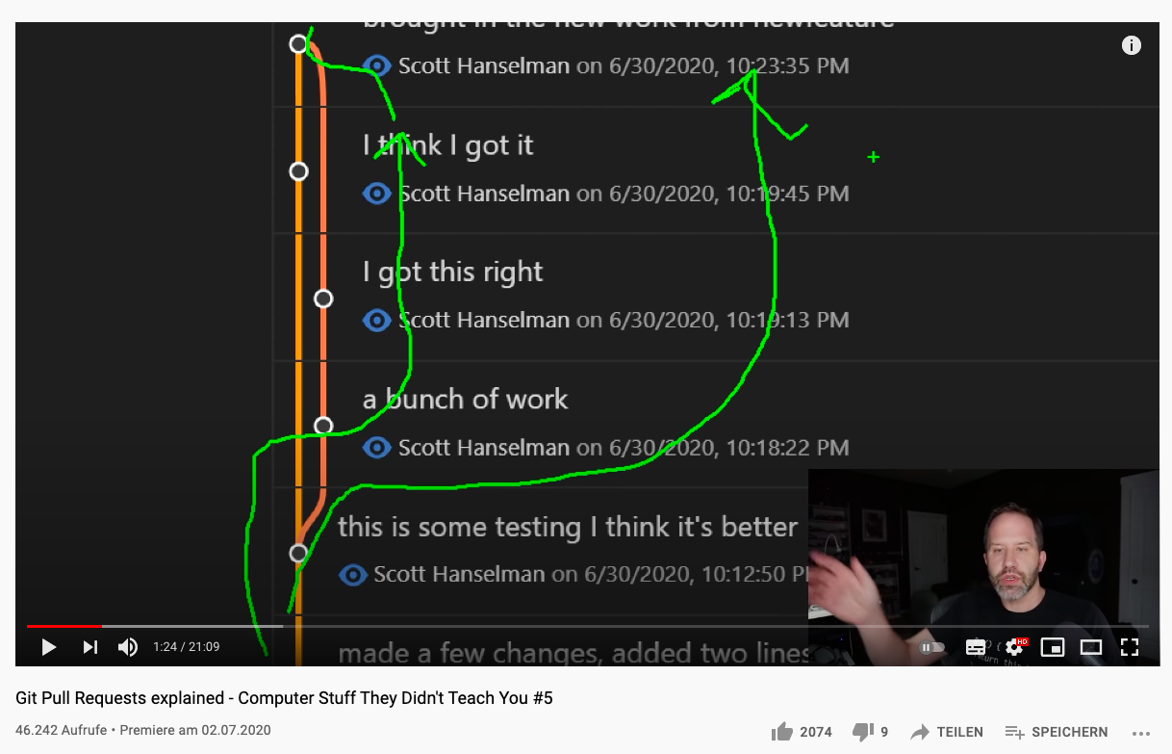
GitHub Pull Requests
Fork Repo
Create new branch
Add changes
Do pull request
Git Pull Requests explained –
Computer Stuff They Didn't Teach You #5

